Slide 1
China
Wei Cui, Cadet, USAF
Notes:
Good morning Capt Morse Good morning Gentlemen.
Im cadet cui and today I am going to give you a brief introduction to China.

Slide 2
overview
Economy
Language
US Interests in China
Notes:
I will cover three perspectives of China. It is Economy what economic achievement it has made, the language in china, and US interests in China. Why china is important to us.

Slide 3
overview
Economy
Language
US Interests in China

Slide 4
ECONOMY
Since 1978, China has gradually become a more market-oriented economy system.
In 2014, China has the second largest economy in the world.¹
In 2016, Chinese Renminbi is included by International Monetary Fund (IMF) as one of five global reserve currencies.²
Notes:
Since 1978, , China has performed a series of economy reform, from a centrally planned one.
According to CIA Factbook. in 2010, China became the world's largest exporter, in 2014, china has the second largest economy in the world.
In 2016, International monetary fund (IMF announced that Chinese yuan is included as of one of five global reserve currencies along with the U.S. dollar, the euro, Japanese yen, and the British pound. Chinese Yuan is the first to be added to SDR since the euro in 1999.
https://www.cia.gov/library/publications/the-world-factbook/geos/ch.html
http://www.heritage.org/research/reports/2015/08/us-national-security-and-rising-china

Slide 5
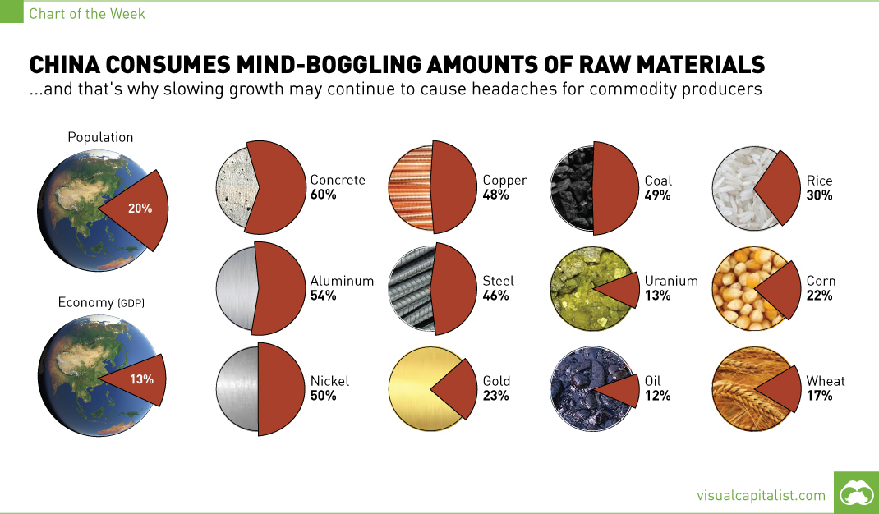
ECONOMY
Key Challenges
High housing price and low domestic consumption³
Corruption and other economic crimes⁴
Environmental damage⁵
http://www.visualcapitalist.com/china-consumes-mind-boggling-amounts-of-raw-materials-chart/)
Figure 1. Amounts of raw materials consumed by China (Adapted from Jeff Desjardins, “China Consumes Mind-Boggling Amounts of Raw Materials”.
Notes:
Despite the rapid economic growth China has made, there are some challenges the Chinese government faces,
China's per capita income is below the world average.
Based on CIA world Factbook on China, high housing price and low domestic consumption.
The median housing price in some big cities such as Beijing and Shanghai has exceeded $1000.00 per sqft.
Economy Crimes and corruptions, BBC news reported in July Chinese four star General Guo was sentenced to life for corruption. He is second general accused of bribes in three years. (http://www.bbc.com/news/world-asia-china-36883608)
and environmental damage. are the three main challenges the Chinese are facing (council on foreign relations http://www.cfr.org/china/chinas-environmental-crisis/p12608)

Slide 6
overview
Economy
Language
US Interests in China

Slide 7

Language
Chinese is spoken by 1.2 billion people in the world.⁶
There are over 10 different types of dialects (e.g. Mandarin, Cantonese).⁷
Written Chinese uses a pictorial representation instead of a phonetic one.⁸
http://www.onetoonechinese.com/learn-to-read-chinese-in-eight-minutes-with-pictures
Figure 2. Courtesy of Learn to read Chinese in eight minutes with pictures
Notes:
Nearly 1.2 billion people (around 16% of the world's population) speak some form of Chinese as their first language. There are over 10 different types of dialects spoken in China ²
Mandarin is the most widely spoken dialect in China. There are more than 800 million people that can understand and speak Mandarin. It is based on the dialect in Beijing, the capital of China. Cantonese is widely spoken dialect in Canton province, Hong kong and Marco. (Charles N. Li, Sandra A. Thompson in their paper Mandarin Chinese: A Functional Reference Grammar (1989) pointed out that people speak different dialects can not understand each other.
However, the written form is shared by all the Chinese speakers.
Unlike many other languages around the world, written Chinese uses a pictorial representation instead of a phonetic one. ¹⁶
picture is from http://www.onetoonechinese.com/learn-to-read-chinese-in-eight-minutes-with-pictures/⁾
The first word on the left means fire in Chinese. Does it look like a pile of bonfire?, and the second one looks likes mountain and Yes, it means mountain, if we use the two words together, the group means volcano.

Slide 8
overview
Economy
Language
US Interests in China

Slide 9
US Interests in china
China is the US’s second largest trading partner.⁹
National Security Language Initiative (NSLI) program, 2006.¹⁰
Military Accession Vital to National Interest (MAVNI) program, 2009.¹¹
Notes:
China is the US second largest trading partner. It is currently the third largest export market and largest import market for the U.S.¹⁷
About one-quarter of the soybeans grown in the U.S. go to China, as well as one in five of planes manufactured by Boeing. Apple now sells more iPhones in China than in the U.S. China is also a big consumer of American services, like education: One in three foreign students in the U.S. is now from China.
U.S. and China cooperate on issues like climate change and counter-terrorism, and China has supported U.S. led efforts to contain North Korea's and Iran's nuclear programs
China has played a big role in addressing global challenges. For instance, nuclear proliferation concerns in North Korea and Iran. Because both Iran and north Korea have close economy and energy ties with China.
In January 2006, the National Security Language Initiative (NSLI) program was introduced by President George Washington Bush to develop the foreign language skills of American students.²¹ Chinese is one of six critical-need foreign languages.²² Since 2009, the Department of Defense has authorized that hundreds of non-immigrant individuals who can speak Chinese and join the military through Military Accession Vital to National Interst program. The inviduals are able to become naturalized U.S. citizens by the time they complete 10 weeks of vigorous basic combat training.²
Currently, the Army is searching for licensed health care professionals and individuals who can speak more than one language. Read the general requirements below to see if you qualify.
Chinese is one of needed languages by United States Army (USA).
Over 100 Chinese speakers join the military via MAVNI every year.
The United States is China’s largest export market and China is currently the third largest export market for U.S. (US Department of State)
The United States seeks to build a positive, cooperative, and comprehensive relationship with China by expanding areas of cooperation and addressing areas of disagreement, such as human rights and cybersecurity. The United States welcomes a strong, peaceful, and prosperous China playing a greater role in world affairs and seeks to advance practical cooperation with China.
The U.S. approach to China is an integral part of reinvigorated U.S. engagement with the Asia-Pacific region.
http://www.heritage.org/research/reports/2015/08/us-national-security-and-rising-china

Slide 10
summary
Economy
Language
US Interests in China
Notes:
This brief was on China. We have briefly covered its econo.my the achievement China has made, the challenges it still facing, We talked about it is language, Manderin and Cantonese are the two dialects, and the U.S. interests in China. Why China is important to us. Chinese is important to our national security interests

Slide 11
End notes
1. The World Factbook, s.v. “China,” (CIA), https://www.cia.gov/library/publications/the-world-factbook/geos/ch.html .
2. International Monetary Fund, http://www.imf.org/en/News/Articles/2016/09/30/AM16-PR16440-IMF-Launches-New-SDR-Basket-Including-Chinese-Renminbi.
3. World Factbook, s.v. “China,” (CIA).
4. BBC News, Chinese Gen Guo Boxiong sentenced to life for corruption, http://www.bbc.com/news/world-asia-china-36883608
5. Council on foreign relations, CFR Backgrounders, http://www.cfr.org/china/chinas-environmental-crisis/p12608
6. United Nations, Official Languages, http://www.un.org/en/sections/about-un/official-languages.
Notes:
This concludes my briefing. Are there any questions?

Slide 12
End notes
7. Charles N. Li and Sandra A. Thompson. Mandarin Chinese: A Functional Reference Grammar (Santa Barbara, CA: University of California Press, 1989), 2.
8. Ibid.
9. US Department of State, US Relations with China, http://www.state.gov/r/pa/ei/bgn/18902.htm.
10. Dina Powell, National Security Language Initiative, https://web.archive.org/web/20080306151344/http://www.state.gov/r/pa/prs/ps/2006/58733.htm.
11. Military Accessions Vital to the National Interest Pilot Recruiting Program, https://www.army.mil/standto/archive/2009/03/10/.
Notes:
This concludes my briefing. Are there any questions?

Slide 13
Questions?
Notes:
This concludes my briefing. Are there any questions?

